Slide 1
Forest Stewardship Plan Result or Strategy Effectiveness Analysis Report 2014
North Island Central Coast
Forest Management Leadership Team Meeting
January 22, 2015
Notes:
Introduction
Goal of presentation – background, linkage to forest management framework, e.g. FSP, FREP, description of report, challenges, questions and feedback.
Attachment

Slide 2
Background
Forest and Range Practices Act
Forest Stewardship Plan (Results or Strategies)
Forest Resource Evaluation Program
Forest Stewardship Plan extensions
Natural resource agency restructuring
Notes:
FRPA – three pillars include planning and monitoring
FSP’s provided opportunity for forest professionals to write the rules used to meet resource value objectives, i.e. Results or strategies
FREP implemented to identify the status of various resource values, e.g. Soils, riparian areas, visuals, stand level biodiversity, etc.
FSP extensions – new concept – rubber stamp or full review and if review, what do we talk about? What’s changed? FREP has made available a lot of data, analysis and reports but it is still not clear how FREP output link back to FSP extension/determination process.
We are now MFLNRO – expanded mandate with diminished resources, i.e. promise of getting staff back out into the field overtaken by authorizations priorities.

Slide 3
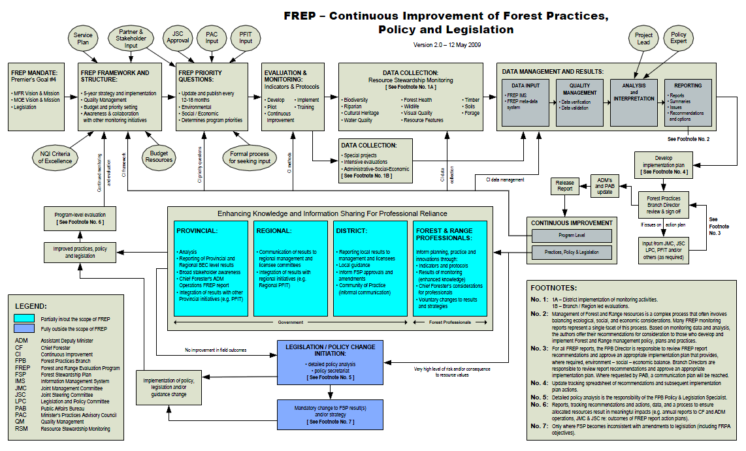
Notes:
Top half of process diagram has to do with how FREP does business (not scope of this discussion) and includes Continuous Improvement loop
Continuous Improvement available to inform FREP business, Practices (and Planning), Policy and Legislation
Our focus is on “Enhancing Knowledge and Information Sharing for Professional Reliance”, i.e. Within scope of practices and planning under current legislative framework.

Slide 4
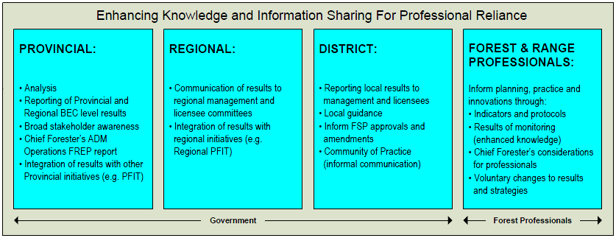
Notes:
Regional – Integration of results with regional initiatives (e.g. Regional PFIT) – i.e. is there a role for CRIT to address FREP results?
District - Inform FSP approvals and amendments, i.e. Support district manager determinations and Community of Practice
Forest & Range Professionals – voluntary changes to results or strategies
Beyond FREP
Original concept of FRPA monitoring foundation included at highly structure program to monitoring identified resource values and a less structured targeted monitoring component to address more specific forest management questions (normally at region or district scale).
In 2011/12, MFLNRO coast forest stewardship group explored opportunities to carry out targeted monitoring (to compliment but not duplicate FREP).
Several options and proposals were assessed but limitation in funding and staff didn’t provide an opportunity to implement a targeted monitoring program.
As an alternative, the group considered how to utilize FREP outputs as part of operational monitoring program.
The proposal was to monitor the effectiveness of Forest Stewardship Plans (FSP’s) by looking at the linkage between results or strategies approved in a FSP and FREP results.
Preliminary data compilation, analysis and reporting work was carried out over 2012/13 with input from FREP program and district staff. In October 2013, the proposal and preliminary results were shared with CRIT to gain operational forester feedback. The resultant discussion identified several challenges. This feedback was considered by the forest stewardship group and the decision was made to move ahead with this work (keeping in mind the identified challenges). This decision was communicated back to CRIT early 2014.

Slide 5
Goal
In relation to FSP approvals, amendments, extensions
Supply quantitative data
Facilitate discussion
Other???
Notes:
The goal of this work is to;
Supply quantitative data (proponent/tenure holder, professional prescribing forester, reviewer, decision maker)
Facilitate discussion with forest tenure holders as part of operational plan decision making process, e.g. FSP approval, amendments, extensions.
Other???
Supply information to support other FRPA determination processes, e.g. GAR, LUP’s
Inform policy and legislation decision making process, i.e. Does the data tell us the legislative structure needs change or not?
May be able to address procedural questions, e.g. How do we know FSP’s are working? Are FSP “rules” effective?

Slide 6
Report Results
Type of result or strategy
Ranking
Indicator performance
Notes:
Report results tell us;
What type and how often various types of R/S are being proposed and approved, e.g. Default, flexible, HLP
FREP ranking for each R/S type, i.e. Good, Fair, Poor
FREP result indicator performance by R/S type (helps focus discussion to specific elements)
The inaugural report includes analysis related to riparian management area and stand level biodiversity resource values.
Report includes a description of analysis process as appendix
The intent is to utilize additional FREP data as it becomes available yearly to update the data and add analysis for other resource values, e.g. visuals, in following years.
Note;
No big surprises in results, i.e. No smoking gun for riparian and stand level biodiversity
Results consistent with what FREP reports are saying
No big distinction in results between default R/S and Flexible R/S (not sure if this surprising or not?)
Results associated with HLP R/S appear to be better (probably not a surprise)

Slide 7
Challenges
Confirming linkage between R/S and FREP results
FREP Protocols and reporting
Strategic view
Statically valid
Notes:
Analysis attempts to link FSP R/S to FREP results but there is no way of confirming if what was prescribed is what was used (in case where flexibility options is available).
FREP - the debate rages. We didn’t go there, i.e. We took FREP results at face value and only presented factual information based on those results, i.e. No conclusions that were not statically valid and no recommendations.
Each value is being reported on in isolation with no analysis of whether the decision making that lead to the recorded results was part of effort to balance resource value decision making process across multiple resource values.
While FREP has been around for some time, results from FRPA are relatively new, i.e. We have limited results to work with right now. This population will grow giving us a more confidence in results in the coming years.

Slide 8
Questions/Comments?
Notes:
I’m not planning on going through the report results in detail but I’m willing to take more detailed report results or analysis process questions now or you can forward question and suggestions via email at later date.

